Slide 1
Инфраструктурни решения за контейнеризация

Slide 2
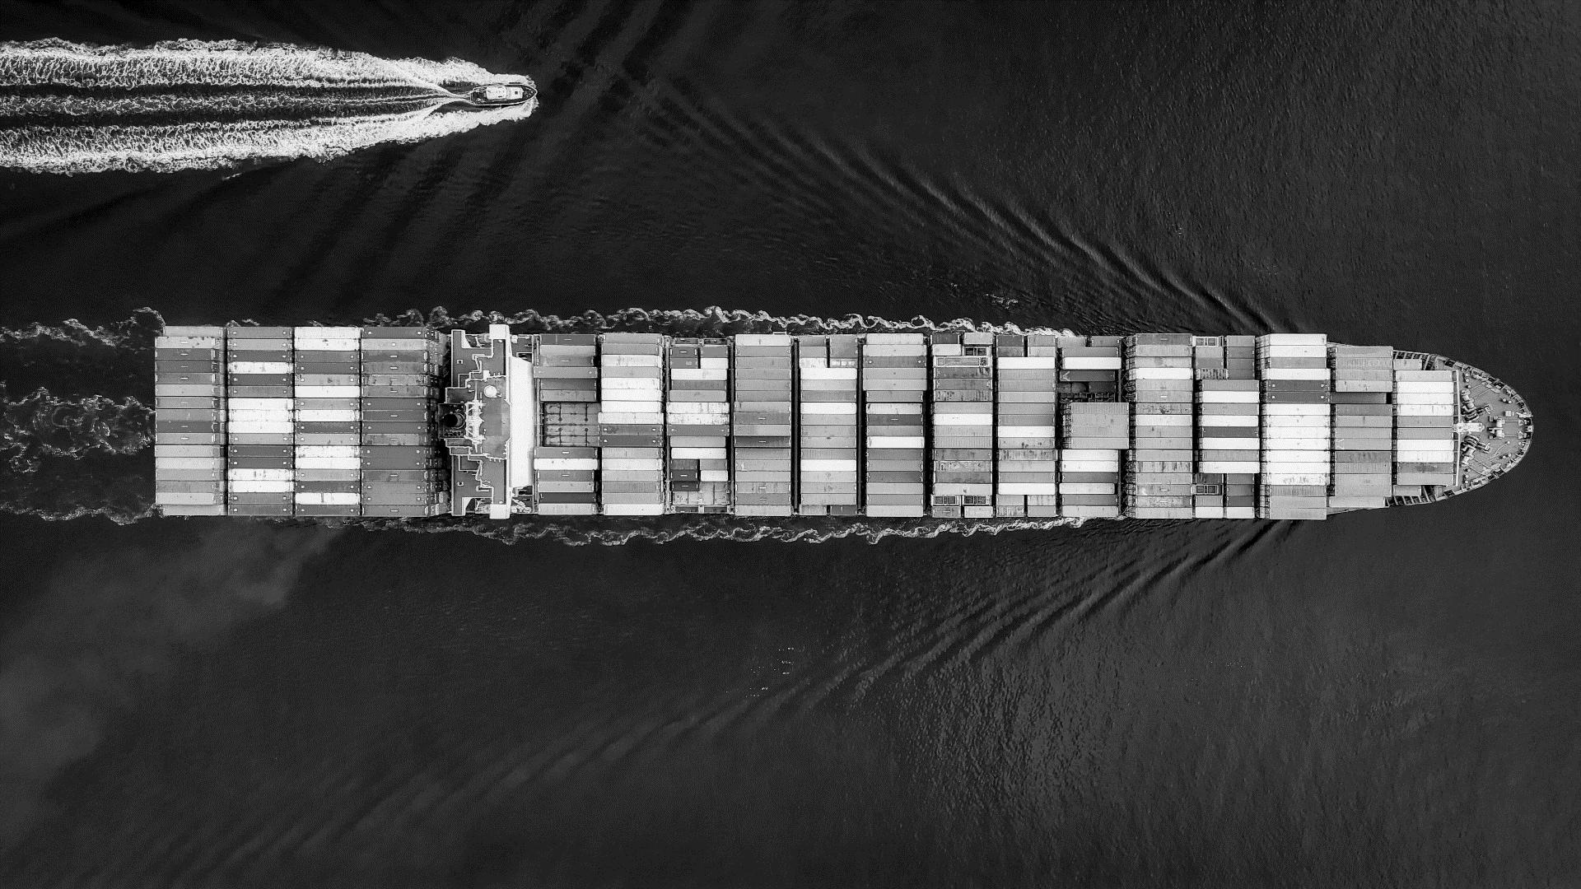
Containerization

Slide 3
What Is Containerization?
Containerization is a technology that enables the packaging of an application, its dependencies and configuration into a single, isolated, and portable unit known as a container.
Container
Container
Container
Container
App
App
App
App
Bins Libs
Bins Libs
Bins Libs
Bins Libs
Container Runtime
Kernel
cgroups
Namespaces
Union filesys

Slide 4
Type Of Containers
OS Containers
Used as an OS - run multiple services
No layered filesystems by default
Built on cgroups, namespaces, native process resource isolation
Exmaples - LXC, OpenVZ, Linux VServer, BSD Jails, Solaris Zones
App Containers
To run a single services
Layered filesystems
Built on top of OS container technologies
Example - Docker, Rocket

Slide 5
History of Container Technology
2001
Virtuozzo Linux Vserver
2004
Oracle Solaris Containers
1999
2007
2011
2014
AppArmor
SELinux
Process Containers
UTS & IPC Namespaces
Cloud Foundry
Warden
Rocket
2005
2013
2016
1979
OpenVZ
LMCTFY
DOCKER
Windows Containers
chroot
UNIX V7
2008
2000
2002
Jails FreeBSD
Mount Namaspaces
LXC – Linux Containers
Cgroups merged into Kernel
PID & Network Namespaces

Slide 6
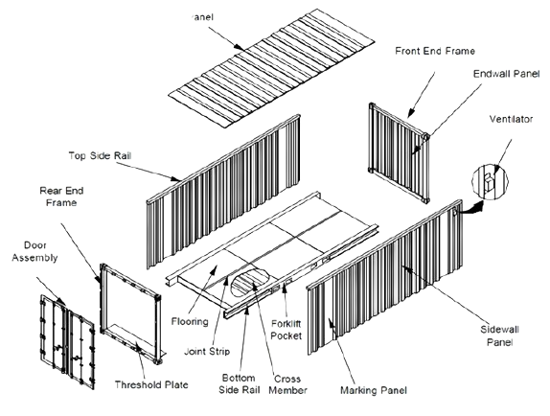
What Are Containers?
Containers allow applications to run in isolated environments, separate from the host system.
Containers provide consistency and portability for software across different environments.
Containers package software in a format that can run consistently on any infrastructure.

Slide 7
Control groups
Cgroups are used to organize processes hierarchically and distribute system resources along the hierarchy in a controlled and configurable manner.
Limit or prioritize resource utilization.
The subsystem are available for Linux:
CPU time
Memory
CPU & Memory Pinning
Block I/O
Freezer (docker pause)
Devices
Network priority
Number of discrete processes (pids)

Slide 8
Namespaces
A namespace wraps a particular global system resource like network, process IDs in an abstraction, that makes it appear to the processes within the namespace that they have their own isolated instance of the global resource
Isolation mechanism for resources
What namespaces are available?
Processes (pid)
Network (net)
Filesystem(mnt)
Inter-process communication (ipc)
Hostname and domain name (uts)
User and group IDs (user)
cgroup

Slide 9
Union filesystem
Unified view of two (or more) filesystems
Efficient use of storage when making minor
modifications to images
Efficient use of storage when starting multiple containers with identical images
Container
(writable layer)
IMAGE (Apache)
BASE IMAGE
(Alpine)
KERNEL bootfs

Slide 10
Virtual Machines vs Containers
VM 1
VM 2
VM 3
Container
Container
Container
App
App
App
App
App
App
Bins Libs
Bins Libs
Bins Libs
Bins Libs
Bins Libs
Bins Libs
Guest OS
Guest OS
Guest OS
Container Engine
Hypervisor
Operating System
Operating System
Hypervisor
Infrastructure
Infrastructure

Slide 11
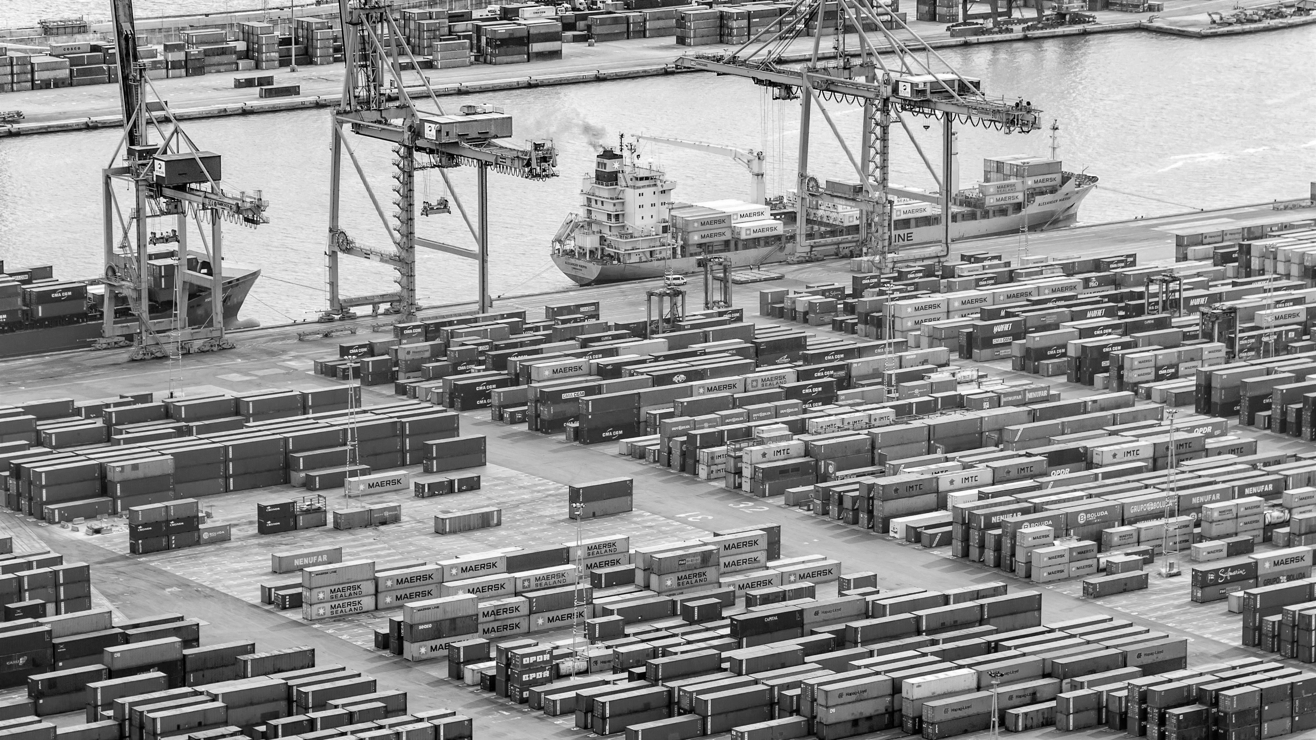
Thank You!

